Slide 1
Will Your Company be Profitable?
Jason Melnik
12/07/2021
DAT-115

Slide 2
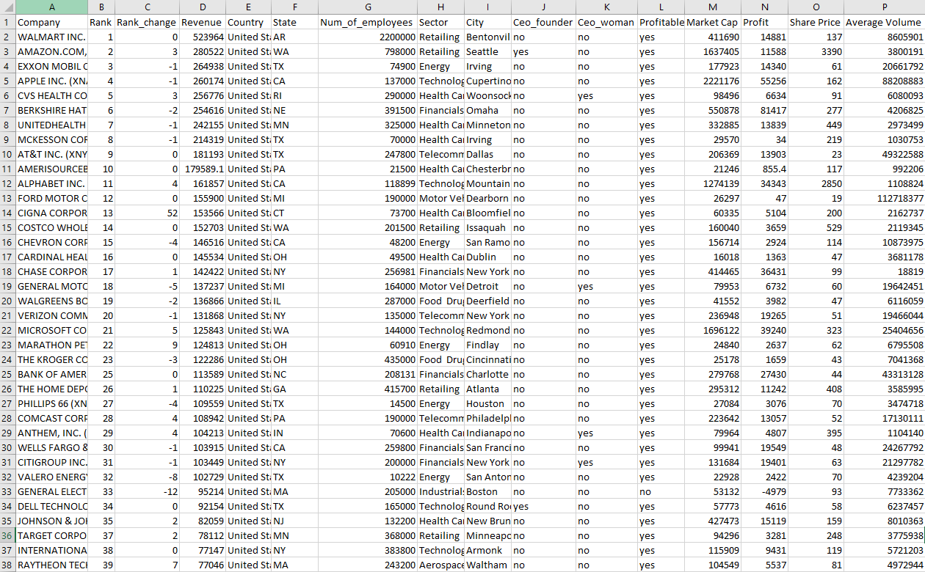
Data Set

Slide 3

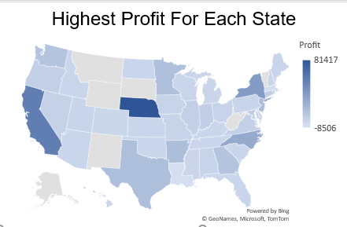
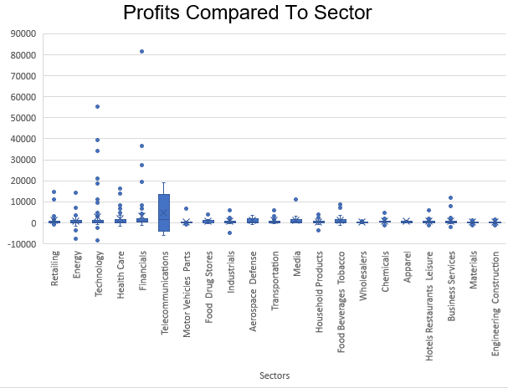
Exploratory Data Analysis - Excel
Map Graph
Box and Whiskers Graph
This graph helps visualize which states have the most profits.
This graph helps visualize which sectors have the highest profits and averages.

Slide 4
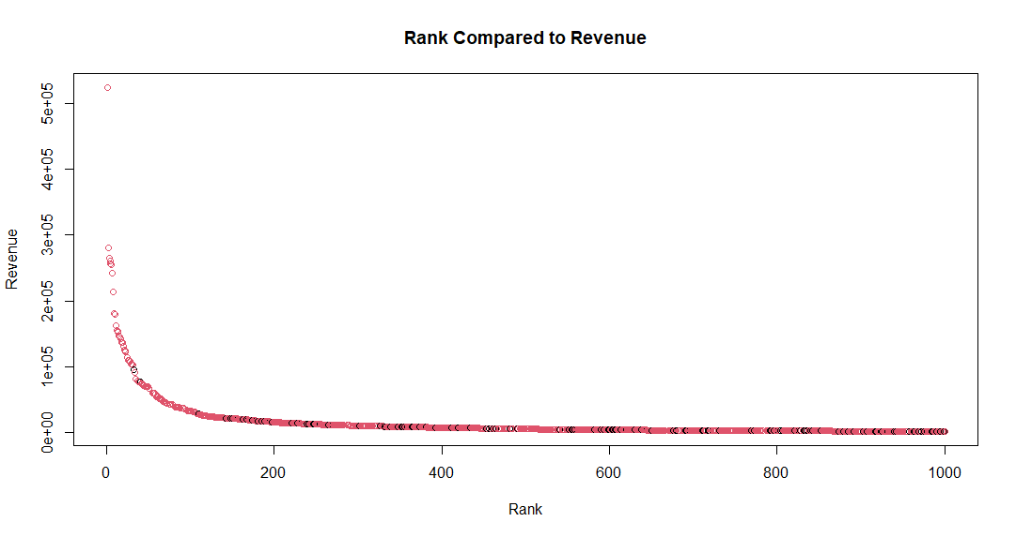
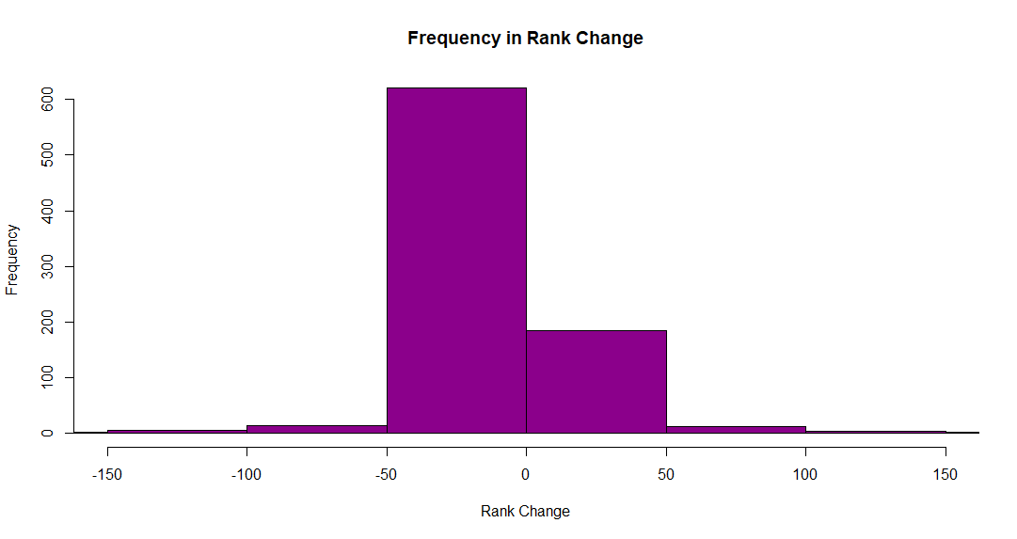
Exploratory Data Analysis – R
Histogram
Scatterplot
This graph shows us that most of the rank changes are between the -50 to 50 range.
This graph shows us that the lower your rank the lower your revenue is.

Slide 5


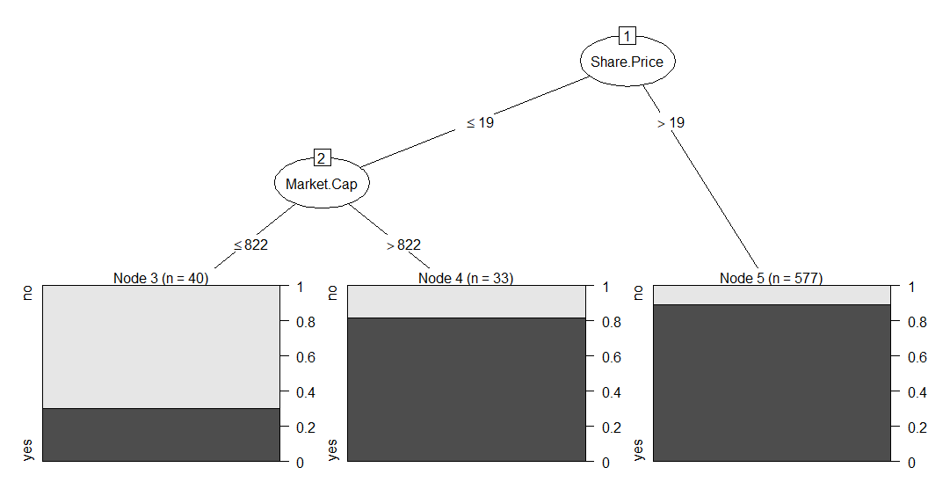
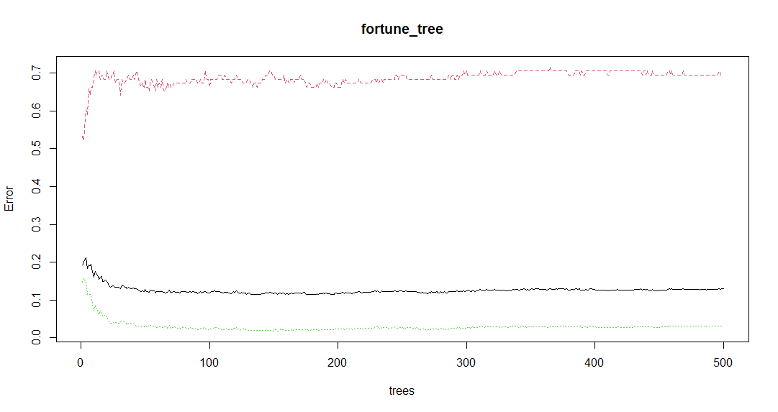
Classification
C5.0
Random Forest
88.0%
88.5%

Slide 6
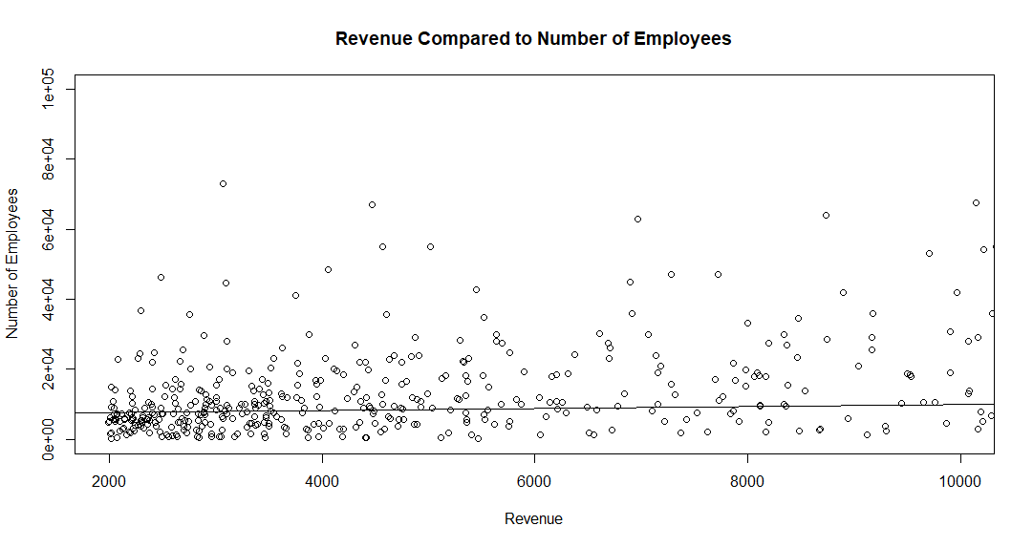
Regression
Linear Regression with determining Revenue based on number of employees had a RMSE of $19,319.68.
After Multiple Regression and finding the perfect model. The best model has all the variables with a RMSE of $9,921.20.

